Slide 1



CREATING REUSABLE CODE WITH R PACKAGES
Bruno Martins
01/10/2025

Slide 2
TABLE OF CONTENTS
Packages. We know them, we use them, why not create them?
Structure and components of a package
{usethis} and {devtools}
Good practices
Installation and deployment
Let’s jump into code

Slide 3
PACKAGES: WE KNOW THEM, WE USE THEM, WHY NOT CREATE THEM?
1.
We are not rewriting the “mutate” nor the “ggplot” function in every project. We use packages for that.
2.
Writing a package is not only for reusing code, but to keep consistency and make sure everyone is using the same version of the function.
3.
It’s very useful in maintainability and making sure everytime a fix is made, everyone get’s the same fix at the same time.

Slide 4
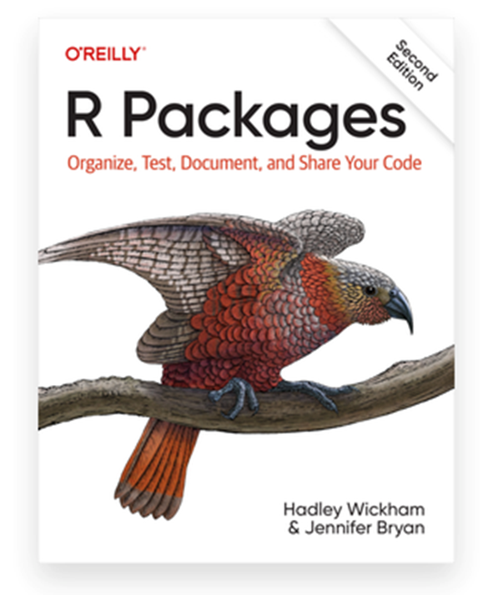
A GREAT BOOK
https://r-pkgs.org/

Slide 5
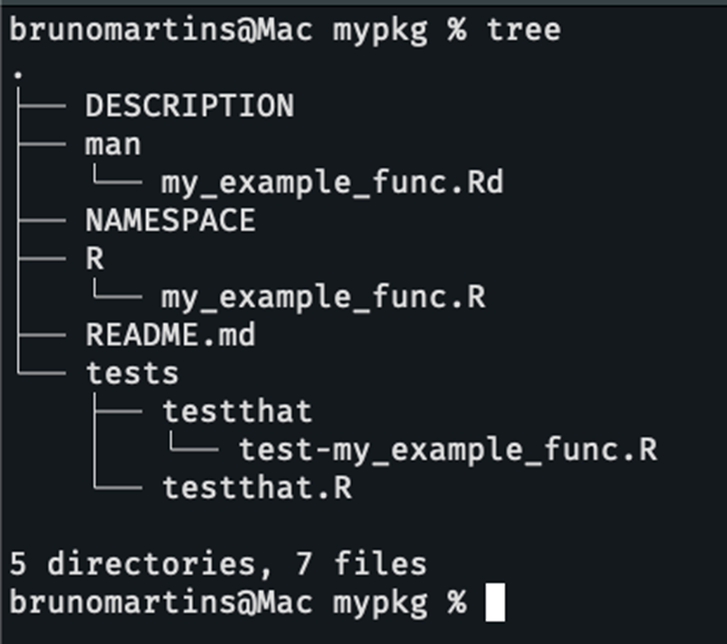
STRUCTURE AND COMPONENTS

Slide 6
{USETHIS} AND {DEVTOOLS}
Packages to help you build all of this automatically.
https://usethis.r-lib.org/ - Automate package and project setup
https://devtools.r-lib.org/ - Automat package development
Usefull functions include: usethis::create_package(dir), usethis::use_r(), devtools::load_all(), devtools::check()

Slide 7

GOOD PRACTICES #1:
VERSION CONTROL
usethis::use_git()
usethis::use_github()

Slide 8
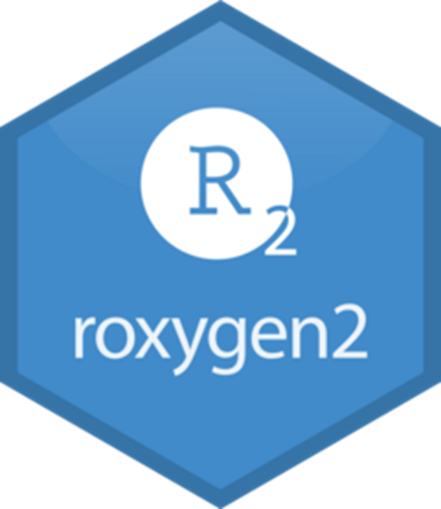
GOOD PRACTICES #2:
ROXYGEN2
#’ @title This is how you make a title
#’ @description This is a description
#’ @param This function takes an argument
#’ @return something
#’ @export

Slide 9

GOOD PRACTICES #3:
DEPENDENCIES
Instead of importing all of dplyr to use mutate across our package, we should import only dplyr::mutate
This makes is explicit and avoids NAMESPACE conflicts

Slide 10

GOOD PRACTICES #4:
BOOK
The R-Packages book gives really good tips and ideologies on how you should split your functions into files, naming conventions, among others….

Slide 11

GOOD PRACTICES #5:
TDD
Test driven development
NOTE: I use {testthat}, but {cucumber} has been making a surge as well as a testing framework for R
“It’s great to work on a codebase with tests, it’s not great to be the one writing those tests ”

Slide 12

DEPLOYMENT
Publishing to CRAN is free
You can also host on GitHub
devtools::install_github()

Slide 13
LET’S CODE?
THANK YOU
Bruno Martins
01/10/2025

